Slide 1
Early Teachers of Chemistry
Gary Patterson
HIST/CHED Workshop

Slide 2
Chemistry in Antiquity
Practical artisanal chemistry
Pigments
Ornaments
Metallurgy
Pottery
Medicines
Cleaning supplies
Flavors

Slide 3
Apprenticeship in Chemistry
Most chemists in antiquity learned their practical chemistry as an apprentice in a guild workshop
Miners worked under a master miner
Apothecaries worked under a master medicine man.
Metalworkers worked the bellows at the forge.

Slide 4
Chemistry in Medical Schools
Eventually, medical schools were formed to instruct aspiring physicians.
Most medical theory was incoherent and downright dangerous
But, the materia medica had been developed over centuries
Detailed recipes existed
General principles of chemistry

Slide 5
Andreas Libavius (1555-1616)
Taught in the German Gymnasium system
Master of the trivium: grammar, rhetoric and dialectic
Knew many classical languages and Patristic authors
Organized Chemistry for medical students in a transparent and informative way
Actual substances and actual recipes
Demonstrations of chemical processes

Slide 6
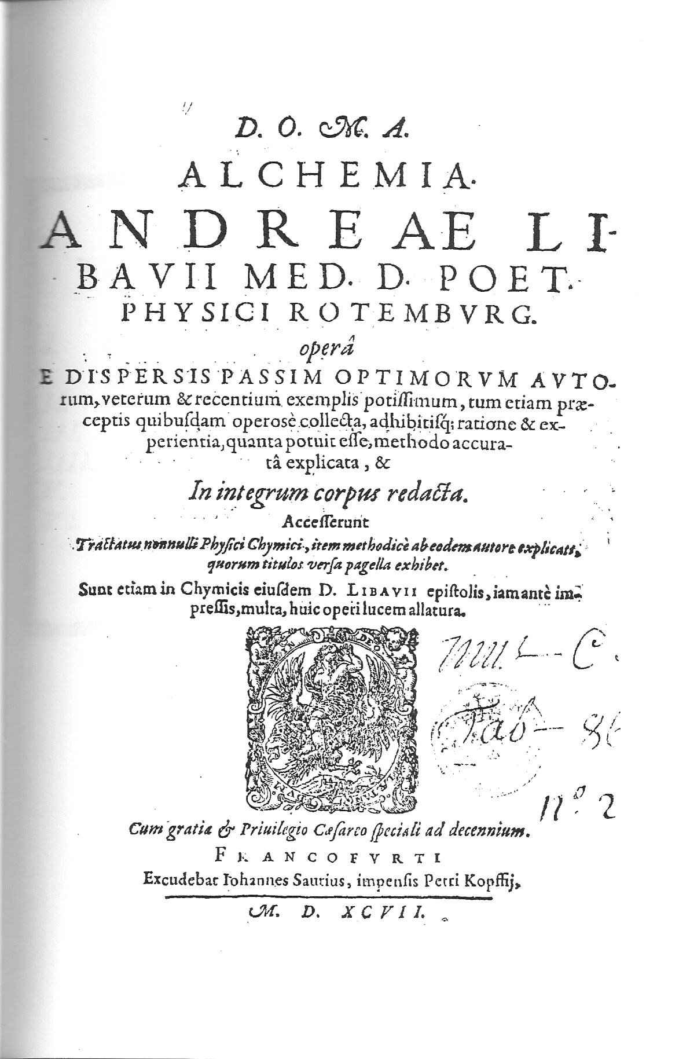

Slide 7
Chemical Philosophy
Opposed Paracelsian “enthusiasm” and “obscurantism” (Private revelation)
Promoted the independence and dignity of Chemistry
Founded on publically known and verified observations
Conceptual world known and debated by all the academic chemists

Slide 8
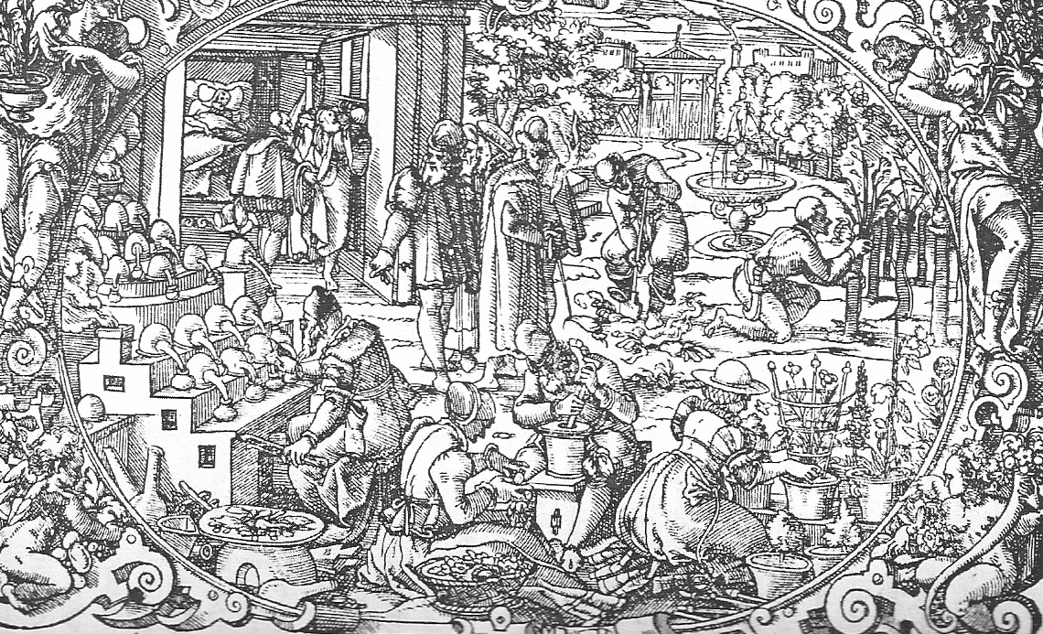
Gallery Furnace

Slide 9
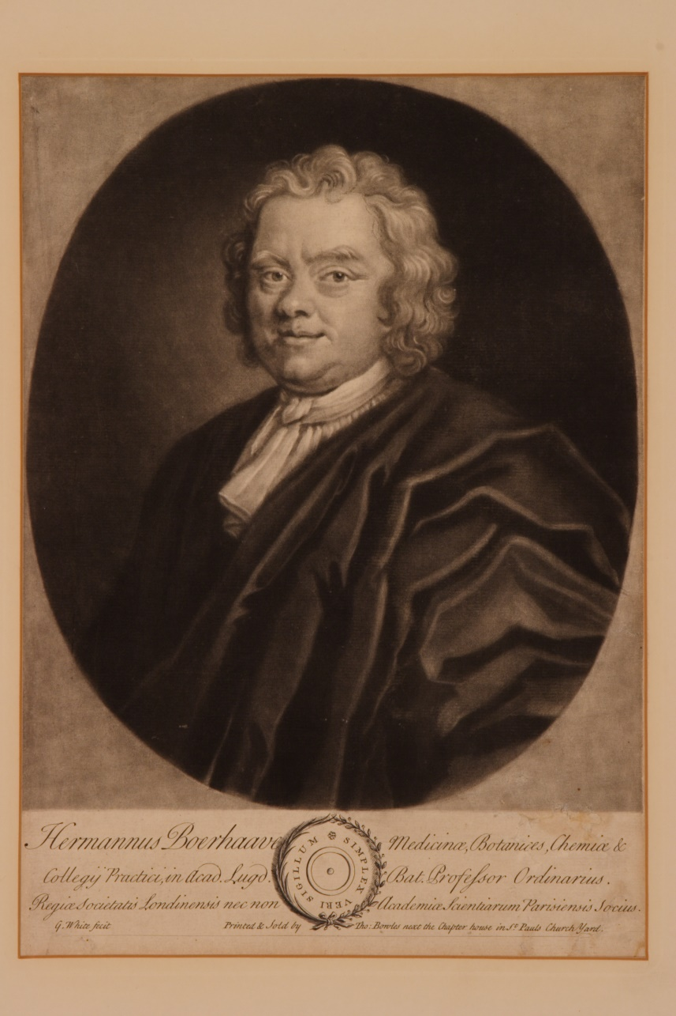
Herman Boerhaave (1668-1738)

Slide 10
University of Leyden
Professor of Medicine, Botany and Chemistry
Finest “Physic Garden” in the world
Collaborated with Linnaeus
Successful physician who did not kill most of his patients!
Lectured in Latin so that Leyden became the world center of Chemistry and Medicine

Slide 11
Inaugural Address in Chemistry
“On Chemistry purging itself of its errors”
Committed to observable reality
“Chemistry is an Art, that teaches us how to perform certain physical operations, by which bodies that are discernible by the senses, or that may be rendered so, and that are capable of being contained in vessels, may be thence produced, and the causes of those effects understood by the effects themselves, to the manifold improvement of various Arts.”

Slide 12
Boerhaave as Newtonian, not Paracelsian
Matter is composed of small particles that interact with one another, both with repulsive forces at small distances and attractive forces at larger distances.
Founder of genuine concept of “chemical affinity.”

Slide 13
Elementa Chemiae (1734)

Slide 14
Chemistry as an Experimental Science
Boerhaave’s Rules for chemical experiments
Control and measure all external variables: P,V,T, composition, light, electric and magnetic fields
Precise weighing
Precise temperature with Fahrenheit thermometer
Good Dutch microscopes
Good gas handling apparatus (Air pump)

Slide 15
Historical Setting
Boerhaave had read all the known chemical books in 1734. He knew many languages including Greek, Arabic and Latin.
Understood the dynamic nature of chemical knowledge
Related all “chemicals” to their actual industrial history
Minerals, vegetables, animals

Slide 16
Tools of the Chemist

Slide 17
Thomas Thomson on Boerhaave
“His system of chemistry was undoubtedly the most learned and most luminous treatise on chemistry that the world had yet seen; it is nothing less than a complete collection of all the chemical facts and processes which were known in Boerhaave’s time, collected from a thousand different sources, and from writings equally disgusting from their obscenity and their mysticism. Everything is stated in the plainest way, stripped of all mystery, and chemistry is shown as a science and an art of the first importance, not merely to medicine, but to mankind in general. But, the real information which it communicates is prodigious, and when we compare it with any other system of chemistry that preceded it, the superiority of Boerhaave’s information will appear.” (History of Chemistry, 1830).

Slide 18
Importance of Demonstrations
Boerhaave conducted more than 200 detailed demonstrations
Volume 2 contains descriptions of them all
What happens when? The most important question in chemistry!
Isolated “facts” are meaningless, unless they are connected to actual chemical phenomena

Slide 19
The First Real Chemical Philosopher
Experiments as part of a construction of a reliable chemical philosophy
Not mere “stamp” collecting or mere “philosophizing.”
Coherent concepts that relate real phenomena

Slide 20
William Henry (1774-1836) The Elements of Experimental Chemistry
The best English textbook of the early 19th century.
Based on John Dalton’s “A New System of Chemical Philosophy” (1808)
Intended for working chemists rather than for premedical students at a University
Heavily influenced the Sillimans at Yale, and most other American University Professors

Slide 21
Manchester
The greatest center of Chemical Philosophy in the early 19th century was Manchester.
Founded the Manchester Mechanics Institute (became UMIST).
Very active member of the Manchester Literary and Philosophical Society
Influenced Dalton by his seminal studies of chemical systems involving dissolved gases

Slide 22
Royal Society of Chemistry
Received Copley Medal for his outstanding experimental work on gases. (1808)
Elected Fellow (1809)
Constant contributor

Slide 23
The Chemical World of William Henry
Joseph Black from Edinburgh (Henry did have an M.D. from Edinburgh)
Humphrey Davy (Royal Institution) Electrochemistry
William Hyde Wollaston (FRS) Brilliant experimentalist in London
Josiah Wedgwood (Manchester) Famous potter

Slide 24
Continued
Antoine Lavoisier (France) Forward looking chemistry cut short by the guillotine
Claude Berthollet (France) Circle of Arcueil
Joseph Gay-Lussac (France) Chemical Physicist at the Sorbonne
Jacob Berzelius (Sweden) Royal Swedish Academy of Science
Count Rumford (Royal Institution)

Slide 25
Henry’s Law of Pedagogy
Know your subject at the highest level
Present only things that you have verified to be true
Create a coherent paradigm that comprehends all the phenomena you present
Be clear that Chemistry is a “living” science and that our understanding is continuing to improve

Slide 26
Mrs. Jane Marcet (1769-1858) Chemistry for Everyone
Widely pirated in America
Understandable by all literate students
Conversational style
Broad scope of real chemistry
No smoke and mirrors

Slide 27
Conversations on Chemistry
Published anonymously in 1805
With attribution in 1832
Based on the chemistry of Humphrey Davy and John Dalton
Inspired Michael Faraday

Slide 28
A Woman for her time
Born into a very wealthy family (Haldimand) and privately educated at a very high level
After her mother’s death, she managed the family and traveled widely
Married a physician who eventually taught chemistry and then pursued it full-time when Jane’s father died
Part of a famous circle of writers and scientists

Slide 29
Pedagogical Philosophy
The unity of all science as a form of Natural Philosophy: “Conversations on Natural Philosophy” (1805)
Full context: Misconceptions, Objections, Clarifications, Extensions
Clearing away errors is essential to building understanding
(Still a major problem in college teaching!)

Slide 30
Marcet’s Chemistry
Mrs. B: “The object of Chemistry is to obtain a knowledge of the intimate nature of bodies and their mutual action on each other.”
The Elements: 57 pure substances that comprise all compounds
Presents a scheme connecting each element with its compounds
Chemistry of relative attraction

Slide 31
Summary
Great teachers of Chemistry know a lot of Chemistry
They can tell stories about the Chemistry that truly illuminate the underlying principles exhibited by the observable phenomenon
They can envision the “mind of the student” and try to both clear away misunderstandings, but can inculcate clear modes of thinking

